Slide 1
Al-Farabi Kazakh National University
Department of Philosophy and Political Science
Political Science (Introductory Course) lecture 1
Political Thought throughout the History: Antiquity, Classics, and the Middle Ages
by Marem Buzurtanova
marem_buzurtanova@hotmail.com

Slide 2
MODULE 1
POLITICAL THOUGHT THROUGHOUT THE HISTORY
(weeks one-five)
Lecture 2: Antiquity and Classics; Middle Ages
Lecture 3: Renaissance and Enlightenment
Lecture 4: 19th Century
Lecture 5: 20th and 21st Centuries
Seminar 1: History of Political Thought: Revision
Individual Assignment 1. Compare and Contrast the Main Features of Pre-modern and Modern Political Thought

Slide 3
Content of Lecture One
Beginning of history and the nature of ancients states;
Terminology;
Classical Greece;
Later antiquity;
Middle Ages.

Slide 4
How do philosophers influence politics?
?
?
?

Slide 5
How do philosophers influence politics?
ideas and ideologies;
personal influence:
personal participation.
This is why MODULE 1 is all about pholosophers

Slide 6
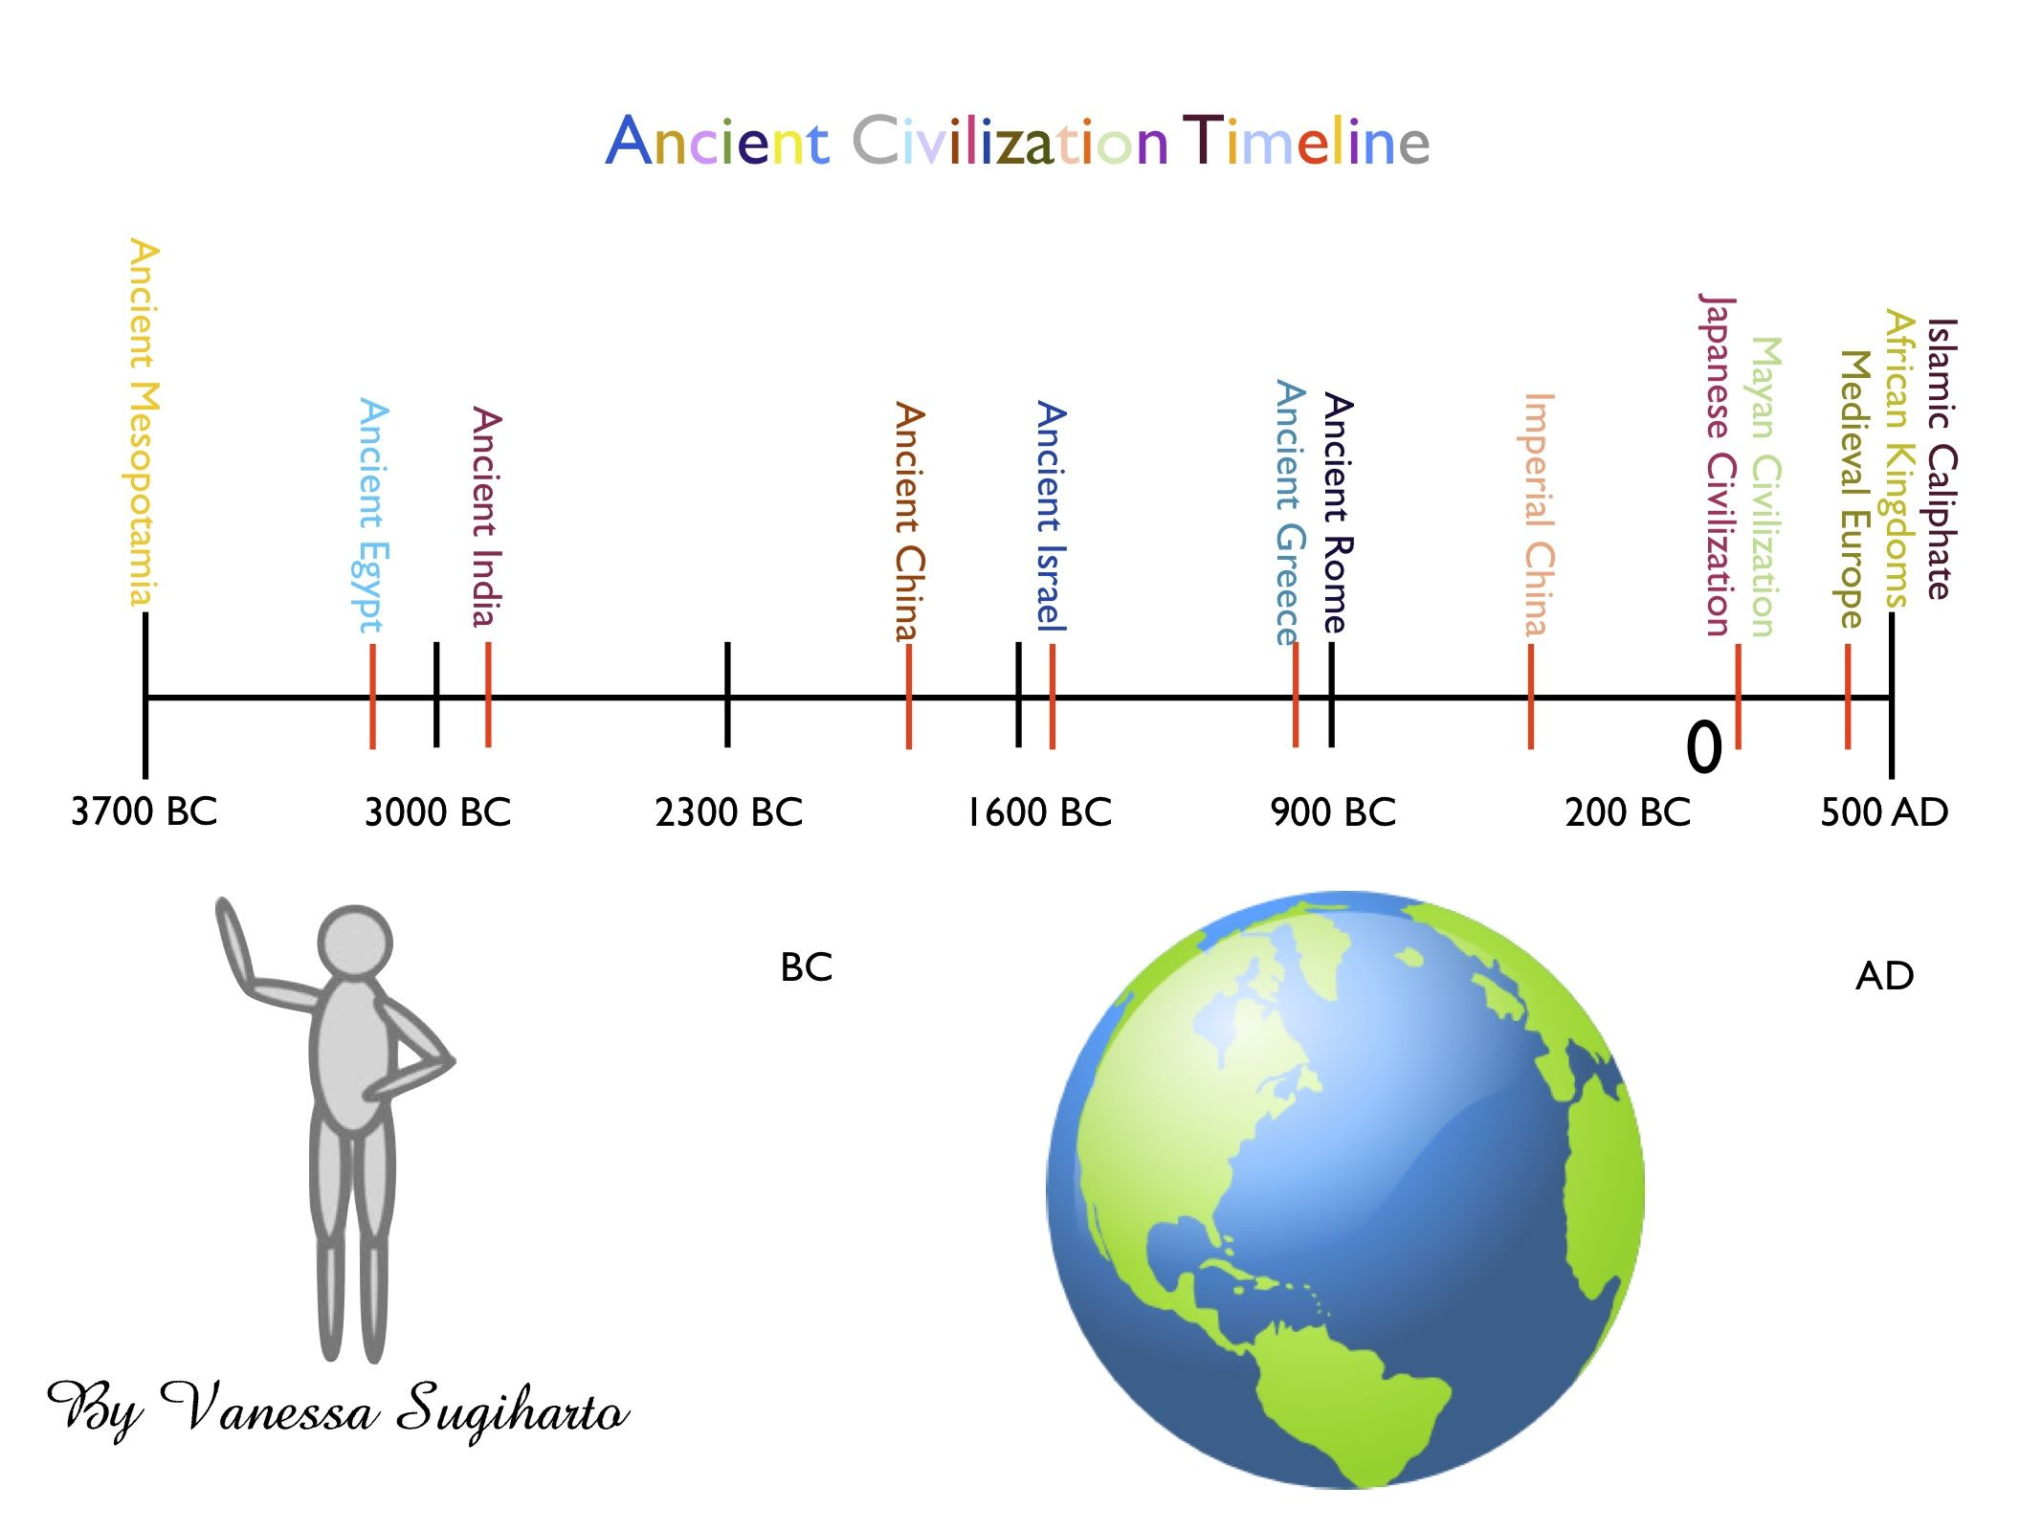
Political Thought throughout the History:
Antiquity, Classics, and the Middle Ages

Slide 7
Political Thought throughout the History: Antiquity, Classics, and the Middle Ages
History starts with the emergence of states. State - a politically structured society within an area under an independent government. The first states arose about 5,500 years ago.
Why states?
Productive economy
Division of labor
Social classes
Cities
Some other terms:
Polis (Greek: πόλις), city, city-state;
Politeia (Greek: πολιτεία).

Slide 8
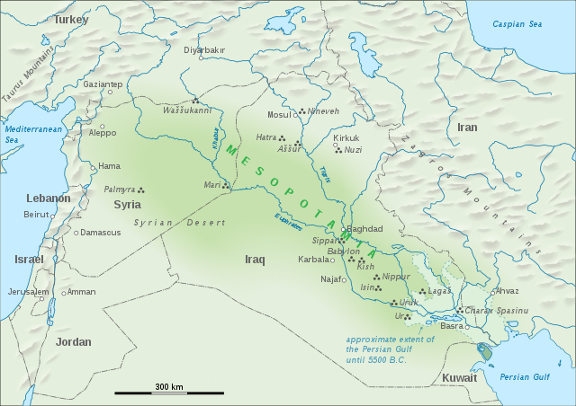
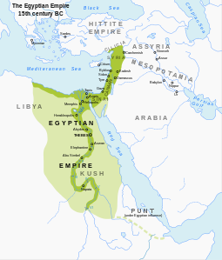
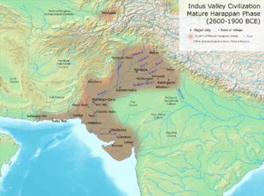
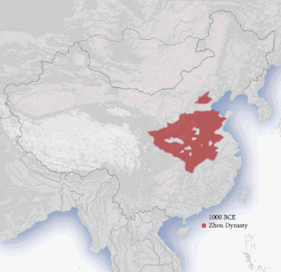
Political Thought throughout the History:
Antiquity, Classics, and the Middle Ages
Mesopotamia Ancient Egypt
Indus Valley Han China
The Babylonian text Dialogue of Pessimism contains similarities to the agonistic thought of the Sophists, the Heraclitean doctrine of dialectic, and the dialogs of Plato, as well as a precrsor to the Socratic method. Buccellati (1981), "Wisdom and Not: The Case of Mesopotamia", Journal of the American Oriental Society 101 (1), pp. 35–47 43.

Slide 9
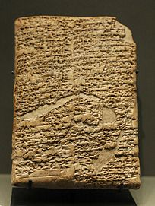
Political Thought throughout the History:
Antiquity, Classics, and the Middle Ages
The Code of Hammurabi
Anu and Bel called by name me, Hammurabi, the exalted prince, who feared God, to bring about the rule of righteousness in the land, to destroy the wicked and the evil-doers; so that the strong should not harm the weak; so that I should rule over the black-headed people like Shamash, and enlighten the land, to further the well-being of mankind. Cited in Mesopotamia: The Code of Hammurabi" edited by Richard Hooker (1996).

Slide 10
Political Thought throughout the History:
Antiquity, Classics, and the Middle Ages
Classical Greece and Rome
The Pre-Socratics - 6th and 5th century BC
Socrates - 470 – 399 BC
Plato - 428/427 or 424/423 – 348/347 BC
Aristotle - 384 – 322 BC
Marcus Aurelius - 26 April 121 – 17 March 180 BC
Cicero - 3 January 106 BC – 7 December 43 BC
φιλοσοφία, philosophia, "love of wisdom"
Peter Adamson: “Philosophy happens in a society capable of producing a philosopher”.

Slide 11
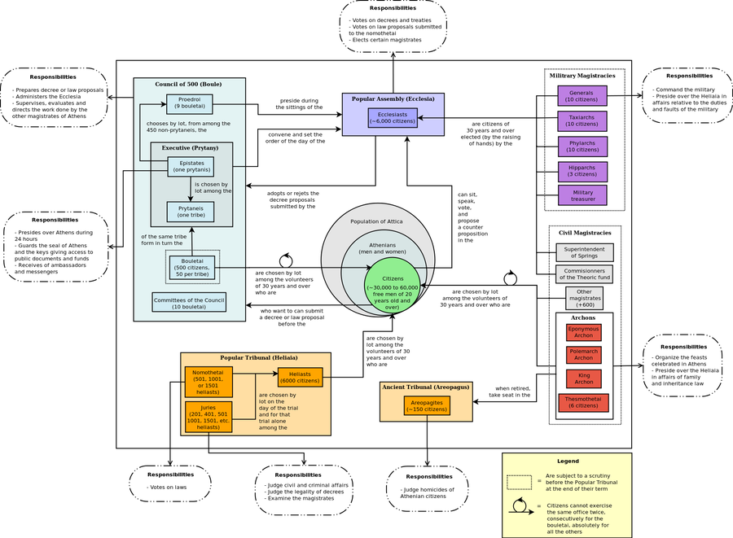
Constitution of the Athens (4th century BC)
What do we know about the democracy in the Athens?
direct democracy;
excluded slaves, women and foreigners;
lasted for 200 years;
was briefly interrupted by oligarchic revolutions twice;
was suppressed by the Macedonians in 322 BC.

Slide 12
Classic Greece and Rome
Socrates
Plato
Aristotle
Cicero
Mark Aurelius

Slide 13
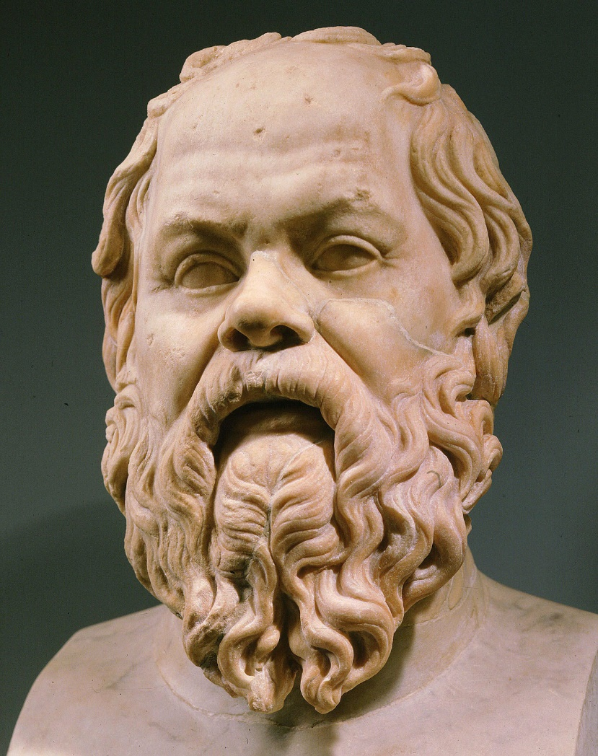
Socrates 470 – 399 BC
What do we know about Socrates?
did not write books;
was extremely ugly and difficult character;
was sentenced to death by poisoning in 399 B.C and accepted this judgment rather than fleeing into exile;
invented socratic method;
Plato was his student.
Invented critical thinking?
Question all!
First public intellectual in history?

Slide 14
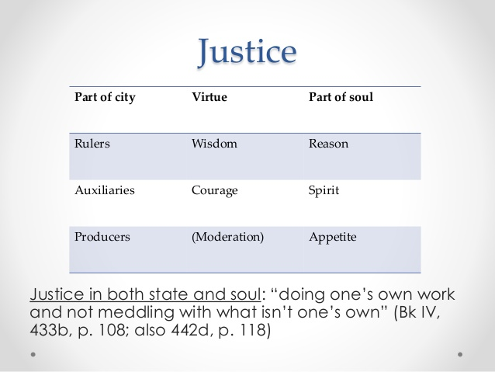
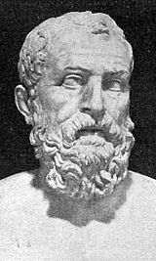
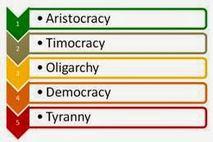

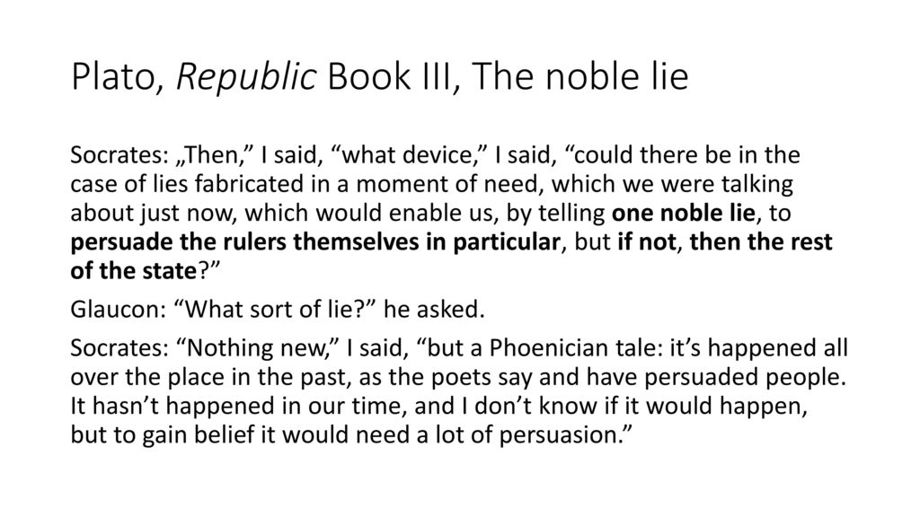
Plato

Slide 15
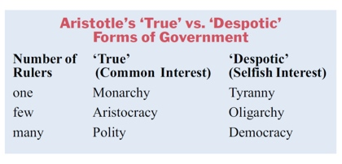
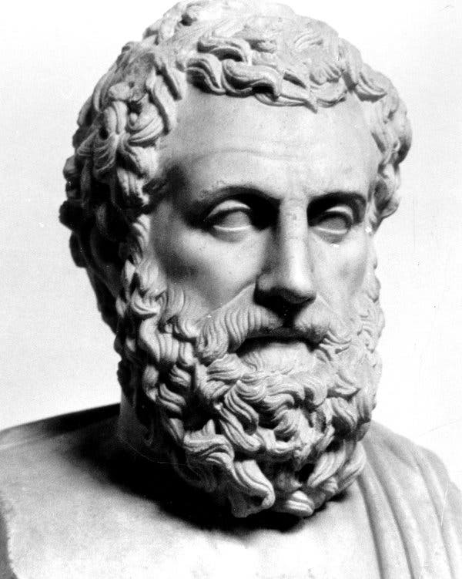
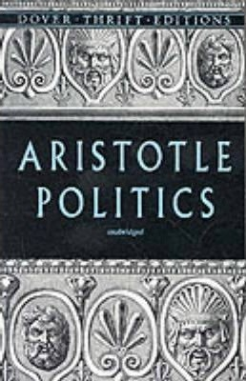
Aristotle
Man is by nature a political animal.
Logos and reason defines man.
Nature does nothing in vain.

Slide 17
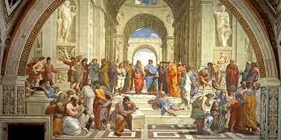
Plato vs. Aristotle
Idealist | Realist
Radical | Pragmatic
Academy | Lyceum
Deduction | Induction
The School of Athens is a fresco by the Italian Renaissance artist Raphael painted between 1509 and 1511

Slide 18
Political Thought throughout the History:
Antiquity, Classics, and the Middle Ages
Later Antiquity and The meddle ages
Augustine of Hippo aka Saint Augustine - 354 – 430
Al-Farabi - 950 – 951
Thomas Aquinas - 1225 – 1274
Ibn Khaldun (1332 – 1406)

Slide 19
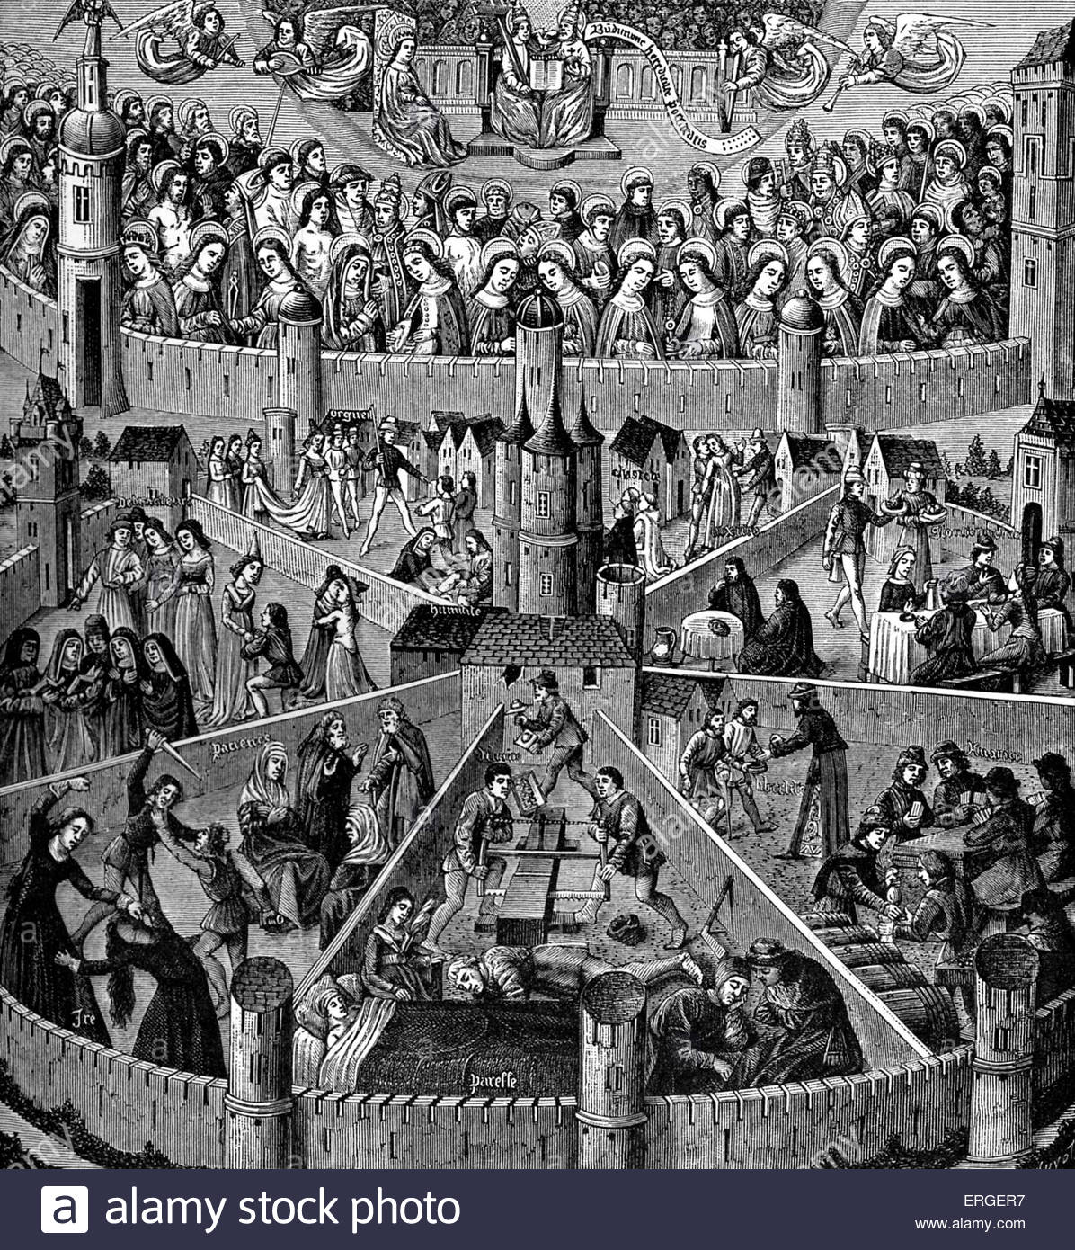
Later Antiquity and The meddle ages
Saint Augustine 354 – 430
original sin
free will
slavery punishment for the existence of sin
city of god

Slide 20
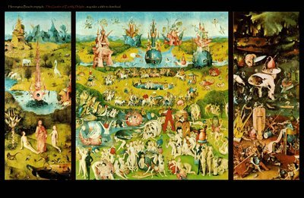
Later Antiquity and The meddle ages
Al-Farabi (950 – 951)
Virtuous City
Al-Farabi dwelt upon Plato’s idea of the philosopher king (the Prophet Muhammad for Muslims as being a perfect ruler and the city-state of Medina), who established the perfect state (utopia) which al-Farabi's theory was a programmed to revive.

Slide 21
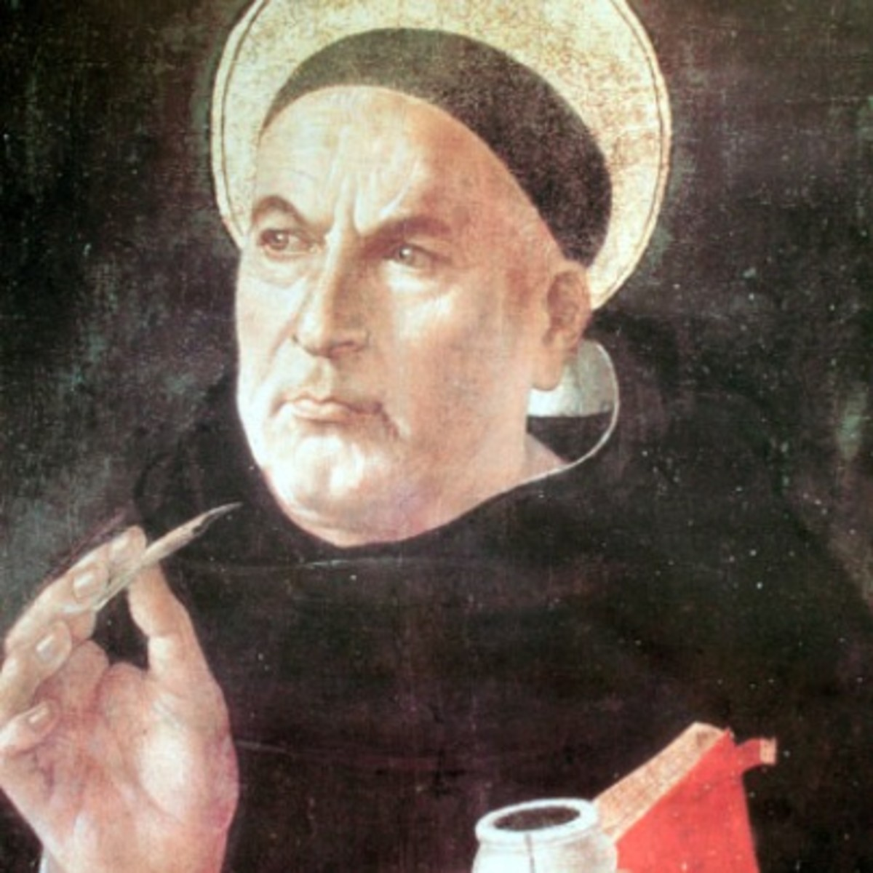
Thomas Aquinas - 1225 – 1274
Christianity Aristotelian Philosophy
Natural Law (Latin: ius naturale, lex naturalis) exists independently of the positive law of men, determined by nature (Aristotle, Cicero) or God (Thomas Aquinas), therefore, is objective, independent of human understanding and universal.

Slide 22
Any questions and/or remarks?

